Slide 1

Scalable Processing of Dominance-Based Queries
Course: Technologies for Big Data Management and Analytics
Fall Semester, 2020-2021
Professor: Apostolos Papadopoulos
Theodoros Konstantinidis
Panagiotis Papaemmanouil

Slide 2




Tasks
Tech Stack
Task 1. Given a set of d-dimensional points, return the set of points that are not dominated. This is also known as the skyline set.
Task 2. Given a set of d-dimensional points, return the k points with the highest dominance score. The dominance score of a point p is defined as the total number of points dominated by p.
Task 3. Given a set of d-dimensional points, return the k points from the skyline with the highest dominance score.
01
02
03
04
05
06
07
08
09
10
11
12
13
14

Slide 3
Skyline Definition
Skyline is a subset of all the tuples that are not dominated by any other tuple of the original set.
Domination Definition
A tuple 𝑎 dominates another tuple 𝑏 (𝑎 ≺ 𝑏) when the values of each of 𝑎’s attributes are bigger (or smaller) than or equal to the corresponding values of 𝑏.
Dominance score
The number of points dominated by the point.
01
02
03
04
05
06
07
08
09
10
11
12
13
14

Slide 4
Workflow
Dataset
d-dim points
Task 1
Skyline Set
Task 2
Top-K points
(dominance score)
Task 3
Top-K from Skyline
Skyline subset
Dataset sorted by dominance score
Skyline subset
Dataset sorted by dominance score
Skyline subset
Dataset sorted by dominance score
First K points from sorted dataset
Filter points belonging to the Skyline subset
First K points from sorted Skyline subset
Results
01
02
03
04
05
06
07
08
09
10
11
12
13
14

Slide 5
All Local Skyline
Baseline approach to the Skyline problem
Parallelizes workload, calculates partial skylines
Final skyline calculated from collected results
Size of data in main memory is not a guaranteed fit
No smart methods to efficiently determine domination
High bandwidth usage
01
02
03
04
05
06
07
08
09
10
11
12
13
14

Slide 6
Top-k Points by Dominance Score
Dataset
Original dataset
Dominance score - Calculation and Assignment
Sorting and result
a
b
c
d
e
f
g
h
i
j
k
l
m
n
o
p
i
b
k
a
f
g
d
h
c
p
n
l
j
o
m
p
Original dataset, sorted
12
14
7
9
0
11
10
8
15
3
13
4
1
5
2
6
15
14
13
12
11
10
9
8
7
6
5
4
3
2
1
0
01
02
03
04
05
06
07
08
09
10
11
12
13
14

Slide 7
Skyline’s top-k Points by Dominance Score
Combination of the skyline and sorted dataset
Original dataset, sorted by dominance score
Filter sorted dataset using skyline
Return result
i
b
k
a
f
g
d
h
c
p
n
l
j
o
m
p
Filter: Keep if exists in
Skyline
c
f
j
p
Sorted skyline
f
c
p
j
01
02
03
04
05
06
07
08
09
10
11
12
13
14

Slide 8
Experimental Design
Experiments
Variables (Degrees of Freedom) in Experimental Design
Total points | 10.000, 100.000, 1.000.000
Dimensions | 2, 4, 10, 50
Distribution | Uniform, Normal, Correlated, Anticorrelated
k (top-k) | 1, 10, 50, 100
cores | 1, 2, 4, 8
Available Hardware - Machine Specifications
Model name | Lenovo-V330-15IKB
OS | Ubuntu 18.04.5 LTS
Architecture | x86_64
Processor | Intel® Core™ i7-8550U CPU @1.80GHz × 8
CPU(s) | 8
Memory | 7,1 Gib
GNOME | 3.28.2
01
02
03
04
05
06
07
08
09
10
11
12
13
14

Slide 9
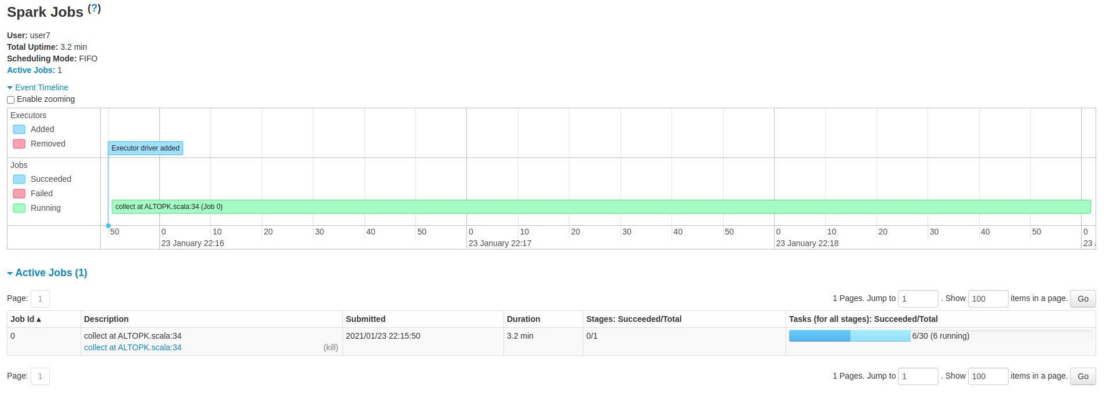
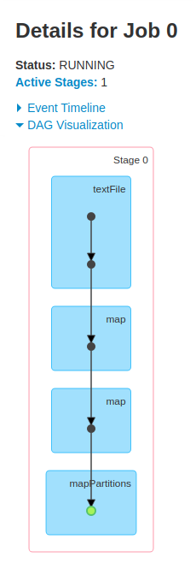
Spark UI
01
02
03
04
05
06
07
08
09
10
11
12
13
14

Slide 10
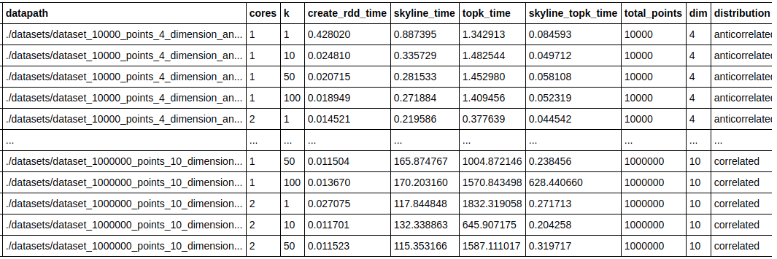

Experiment Results
Planning: |cores| x |k| x |total_points| x |dim| x |distribution| = 4 x 4 x 3 x 4 x 4 = 768 total experiments
Final experiments: ~ 200
01
02
03
04
05
06
07
08
09
10
11
12
13
14

Slide 11
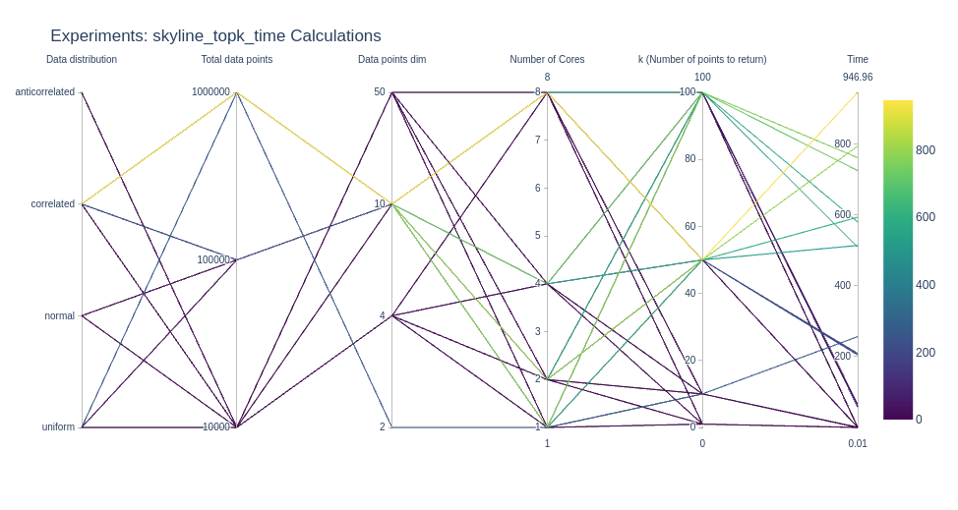
Experiment Times (I)
Parallel coordinates plot
01
02
03
04
05
06
07
08
09
10
11
12
13
14

Slide 12
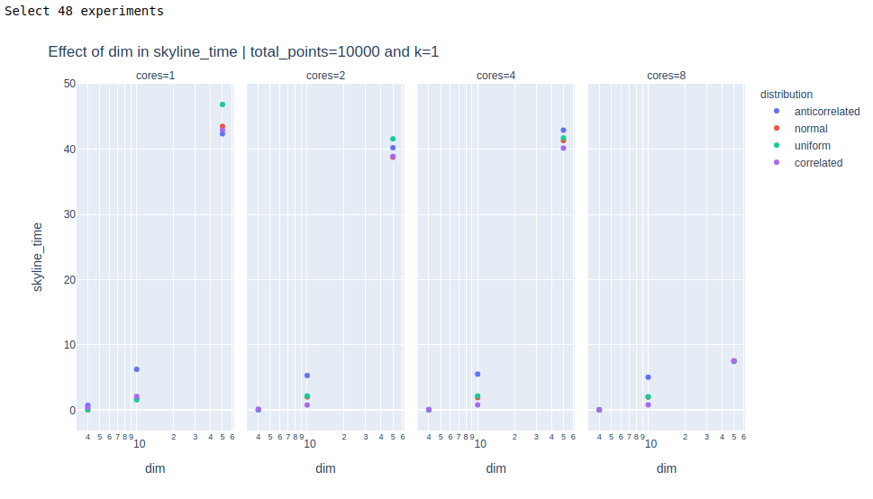


Experiment Times (II)
Time
skyline_time
topk_time
skyline_topk_time
Variables
cores
distribution
total points
dim
k
fix 2 of them
01
02
03
04
05
06
07
08
09
10
11
12
13
14

Slide 13
The top-k algorithm (Task 2) required significantly more time than the skyline algorithm (Task 1).
This is because the skyline implementation uses a sorting step before calculating local skylines while the top-k algorithm compares each point with each other, i.e. it has O(n²) complexity.
The number of dimensions (dim) affects the running time exponentially because it adds to the time to test the domination condition between 2 points.
Using a greater number of cores decreases the running time, if the dataset is large enough.
The parameter k seems to not affect the running time.
Depending on the task, some distributions were evidently faster than others. The anticorrelated distribution was slowest for the skyline calculation task.
Conclusions
01
02
03
04
05
06
07
08
09
10
11
12
13
14

Slide 14

ありがとうございます!

